Slide 1
VRP
Vehicle Routing Problem

Slide 2
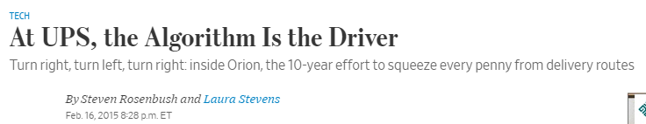
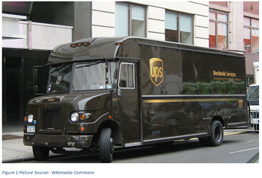
Where is VRP Used
Source: https://www.wsj.com/articles/at-ups-the-algorithm-is-the-driver-1424136536

Slide 3
Where is VRP Used
$200M and 10 years to build
$300M - $400M annual savings expected
Source: https://www.wsj.com/articles/at-ups-the-algorithm-is-the-driver-1424136536

Slide 4
Why is it Hard?
Each route has ~120 stops
There are a lot of ways to order those stops… (like more than a trillion ways)
Source: https://www.wsj.com/articles/at-ups-the-algorithm-is-the-driver-1424136536

Slide 5
Why is it Hard?
Possible ways to order:
6,689,502,913,449,135,000,000,000,000,000,000,000,000,000,000,000,000,000,000, 000,000,000,000,000,000,000,000,000,000,000,000,000,000,000,000,000,000,000,000,000,000,000,000,000,000,000,000,000,000,000,000,000,000,000,000,000,000,000,000,000,000,000,000
Source: https://www.wsj.com/articles/at-ups-the-algorithm-is-the-driver-1424136536

Slide 6
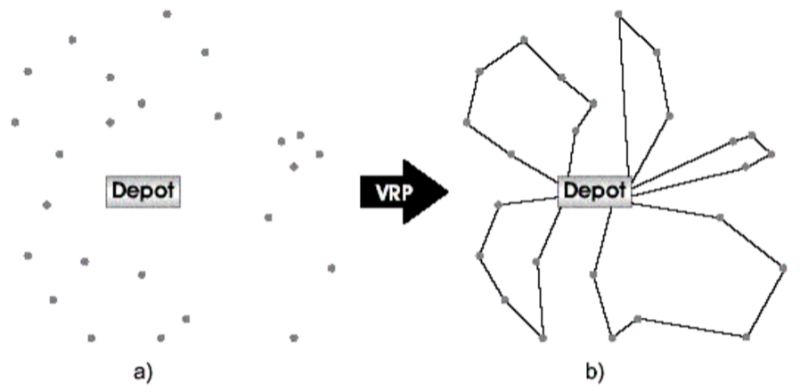
What is the Basic Vehicle Routing Problem?

Slide 7
What is the Basic Vehicle Routing Problem?

Slide 8
How Do you Formulate the Vehicle Routing Problem?
What do you think the objective is?
Minimize distance/cost
What are the decision variables?
Number of trucks, order of stops on a route- (these might prove difficult to write out)
What are the constraints
Must visit every site
Capacity of the vehicle
Time windows

Slide 9

What Makes Routing Interesting?
It is very easy to understand
In practice, it is usually easy to get a feasible solution (assuming you can get enough trucks– which is easy if you use commercially available trucks)
It is actually very hard to solve to optimality (and it is difficult to directly formulate)…
Be careful about what people want the optimization to do and what they are actually doing– they may be violating all kinds of constraints
Notes:
Walmart apple picking from orchard: Our optimal solution was much worse than their baseline. But their baseline violated most of the rules.

Slide 10
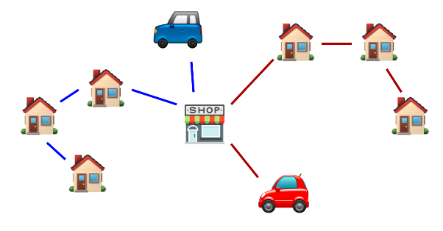
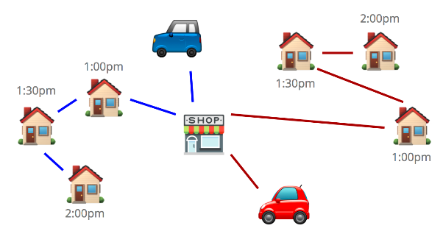
What Makes it Hard to Formulate and Solve?
Delivery Time Windows
https://tech.instacart.com/space-time-and-groceries-a315925acf3a

Slide 11
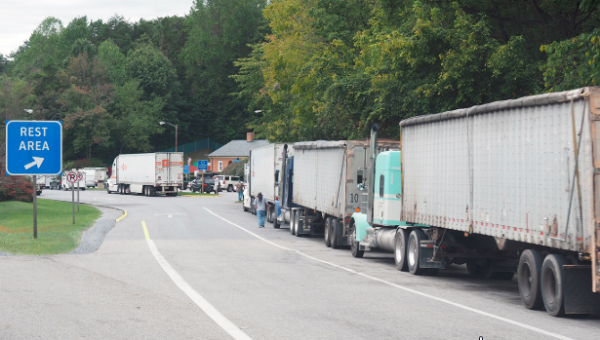
What Makes it Hard to Formulate and Solve?
Driver Rest Requirements

Slide 12
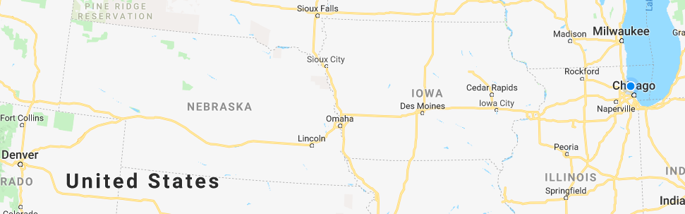
What Makes it Hard to Formulate and Solve?
Non-Uniform Costs– where you end may determine the rate
Denver to Milwaukee to Chicago may be $2.00/mile, but Denver to Chicago to Milwaukee may be $2.20/mile

Slide 13
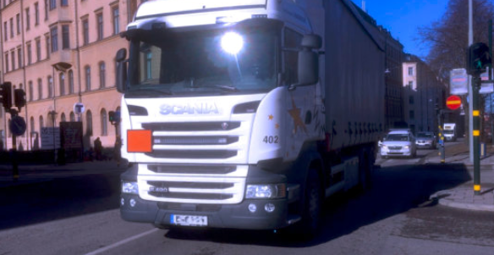
What Makes it Hard to Formulate and Solve?
Restricted times of delivery in cities or center cities or through cities
Non-US major cities can have restricted times (only enter Mexico City at certain times).

Slide 14
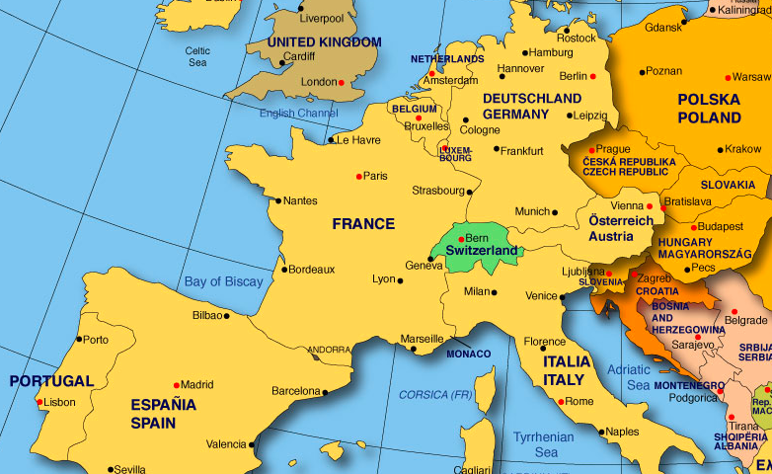
What Makes it Hard to Formulate and Solve?
Crossing Borders… (not easy if the shortest path is through Switzerland)

Slide 15






What Makes it Hard to Formulate and Solve?
Example… (see other case)

Slide 16

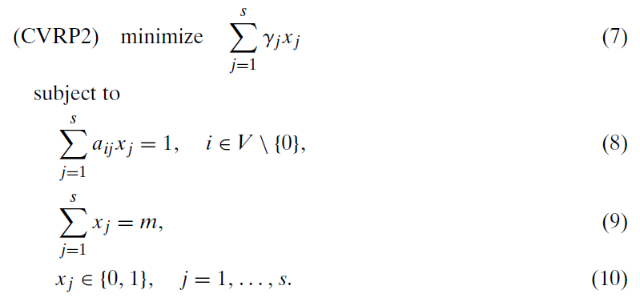
Set Partitioning Formulation of VRP
Sites covered
m-routes
(this can be handled in other ways

Slide 17
What Makes this Problem Hard?
You have to generate all the routes.
This can be impossible!
Works well when there are limited number of customers and stops
Thought exercise: If you have to generate all the routes, why do you need the optimization model– why not pick the best ones?
Answer: The routes generated share many common points

Slide 18
Some Best Practices for Generating the “all” the Routes
Start with all the 1-stop routes first. (Usually this is a good place to make sure you have a feasible solution
Then, add the 2-stops, the 3-stops, etc
Try to look at (validate and cost) each possible route only once (why?)
Try to cut off as many possible routes as possible without having to even iterate through them (why?)
Come up with heuristic rules when you have to cut out routes that are feasible

Slide 19
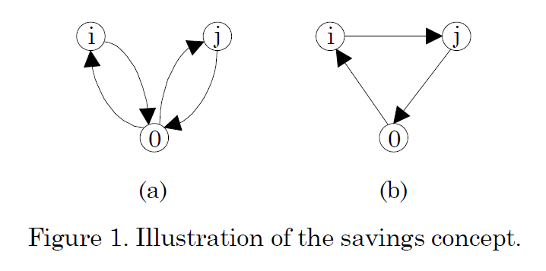
There are many heuristic algorithms for solving routing problems, we’ll look at one: Clarke Wright Savings
The general idea is that we start with simple routes– just go out and back to each point
Then we are going to look for opportunities to combine routes
We will look for these opportunities by creating a simple sorted savings list and go down that list to build routes

Slide 20
Savings Concept
Figure A: Distance = C_{0i} + C_{i0} + C_{0j} + C_{j0}
Figure B: Distance = C_{0i} + C_{ij} + C_{j0}
Savings (intuition). You save one leg out to each i and j
Savings Formula: C_{i0} + C_{j0} - C_{ij}

Slide 21
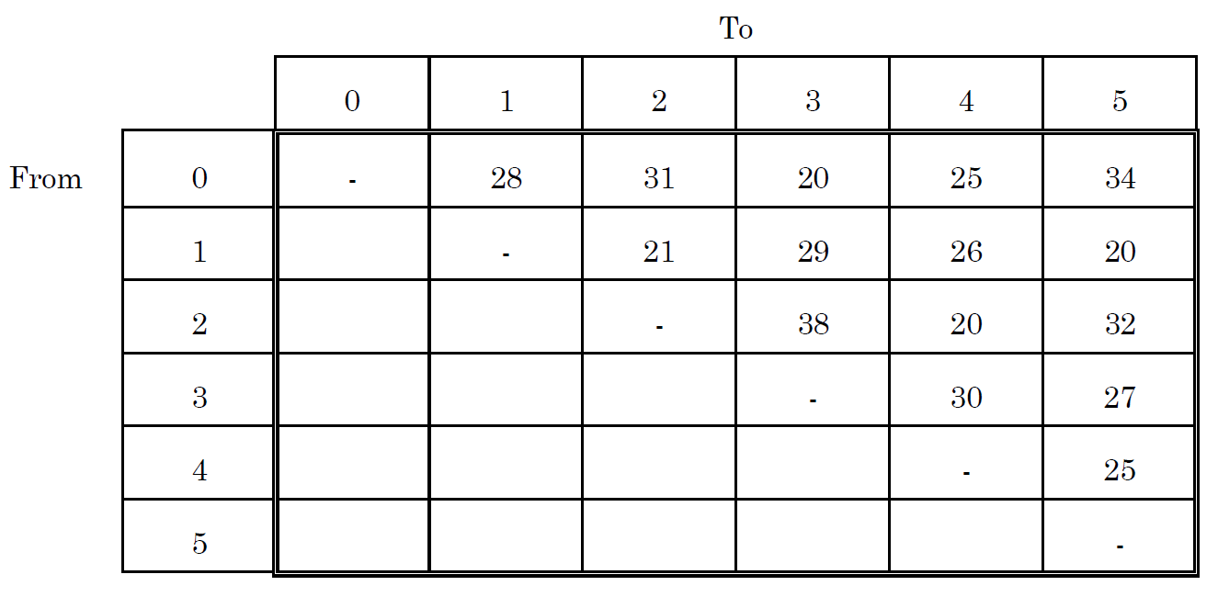
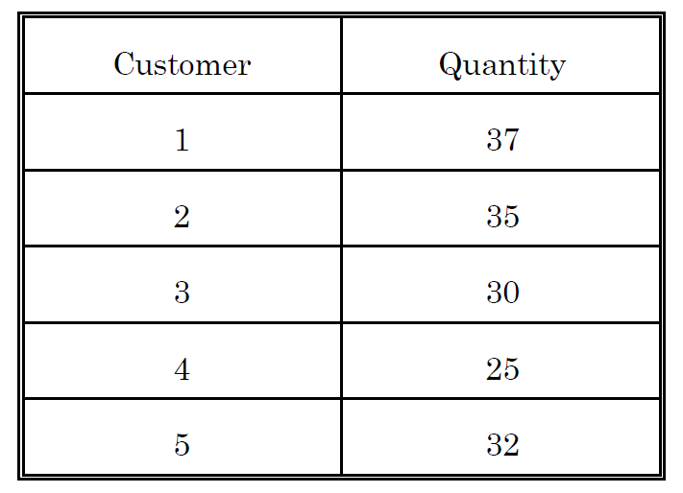
Example Data
Vehicle holds 100 units

Slide 22
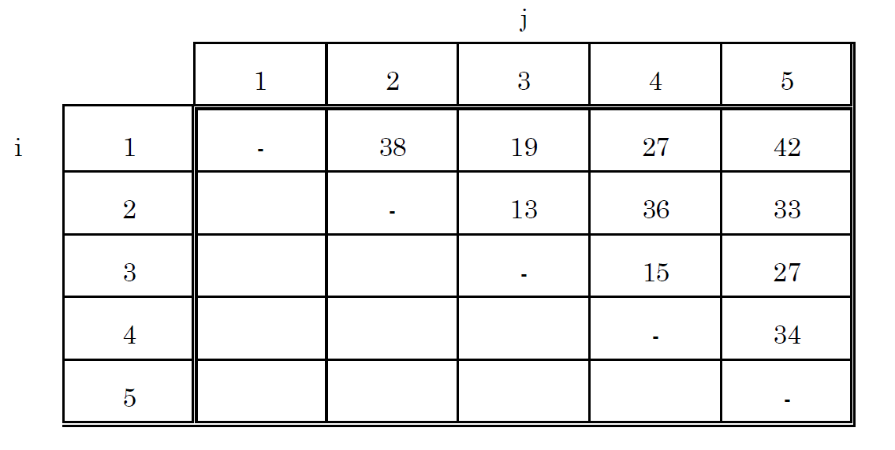
Savings Matrix
C_{i0} + C_{j0} - C_{ij}
Distance
38 = 28 + 31 -21
Savings

Slide 23
Savings Matrix
C_{i0} + C_{j0} - C_{ij}
Distance
19 = 28 + 20 -29
Savings

Slide 24
Savings Matrix
C_{i0} + C_{j0} - C_{ij}
Distance
34 = 25 + 34 -25
Savings

Slide 25
Savings Matrix
Ranking the Biggest Savings
Distance
Savings

Slide 26

Now We Rank the Savings and Run the Algorithm: Sequential
Rank
1-5 are first
We check total capacity (37+32 = 69), we are less than 100 so we are good
1 and 5 are neighbors in final solution
1-2 is next. So route would be 2-1-5 or 5-1-2. But, with 2 capacity would be violated
2-4 is next, but we can’t combine this with 1-5 or we would be building two routes
Adding 4-5 would work– 1-5-4 or 4-5-1. Total demand is 94. We now add 4 to the route
No other stops can be added to this route
So, we go back to the top and start another route, 2-3, the only one left
Total distance is 187

Slide 27
Now We Rank the Savings and Run the Algorithm: Parallel
Rank
1-5 are added, like before
1-2 cannot be added to 1-5 as seen before
But, 2-4 are next and are added as a new route
4-5 is next, but 4 cannot be added to route 1-5 since it is on another route
2-5 is next, but 2 cannot be added to 1-5
1-4 is next, but both are on routes
3-5 can be added to 1-5 (it fits)
Total distance is 171

